Slide 1
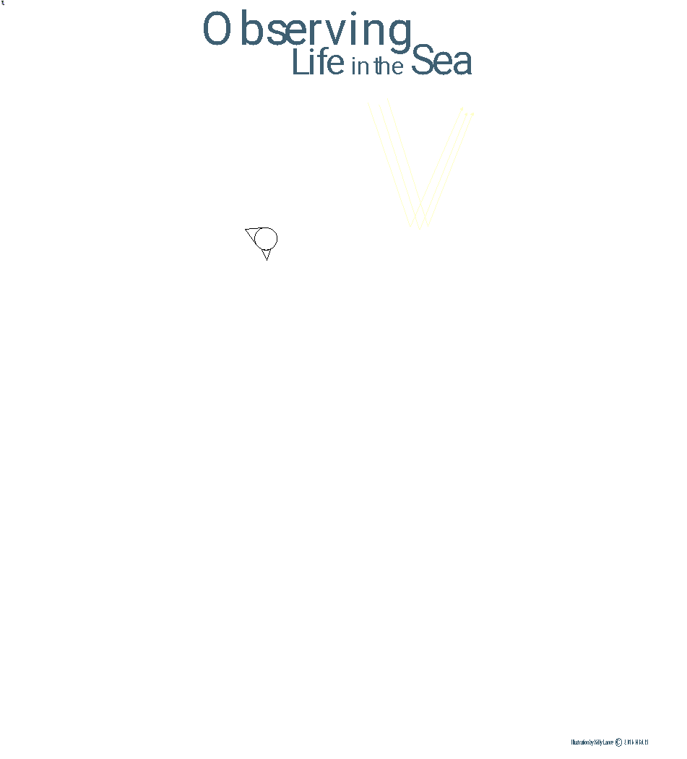
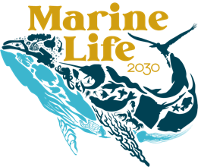
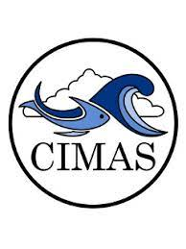
The MBON Pole to Pole: Developing a community of practice dedicated to observing marine life for the benefit of society
Enrique Montes (enrique.montes@noaa.gov)
U. Miami Cooperative Inst. for Marine & Atmospheric Studies - CIMAS
NOAA Atlantic Oceanographic and Meteorological Laboratory - AOML
https://marinebon.org/p2p/
The project is supported by the National Aeronautics and Space Administration (NASA) grant 80NSSC18K0318

Slide 2
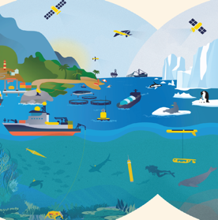
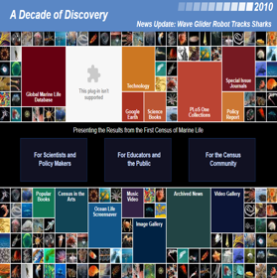
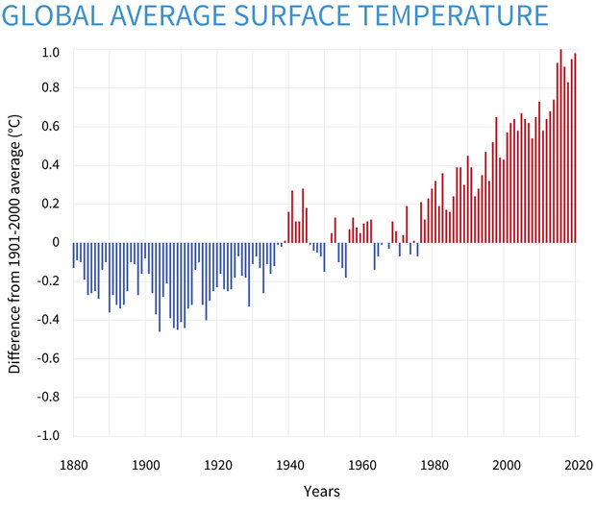
1991
2000
2014
2021
Context: Climate Change, population growth, … and really poor biodiversity knowledge and forecasting ability
The ocean is home to > 200,000 species
Ocean Economy value:
>US $3 trillion in 2030 with many industries depending on healthy ecosystems
Source: OECD 2016
1 billion people
In developing countries depend on fish for their primary source of protein
UPDATED AUGUST 12, 2021
350 million jobs
Are linked to the ocean

Slide 3
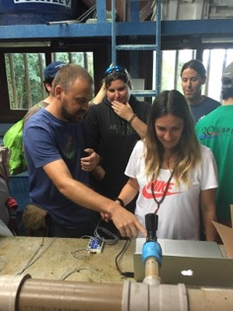
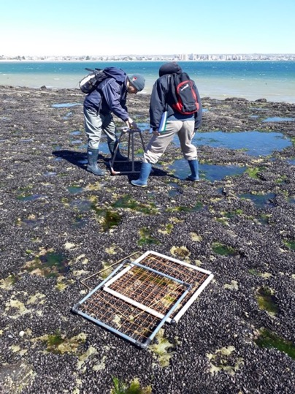
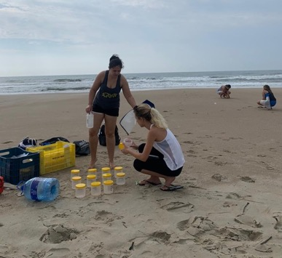
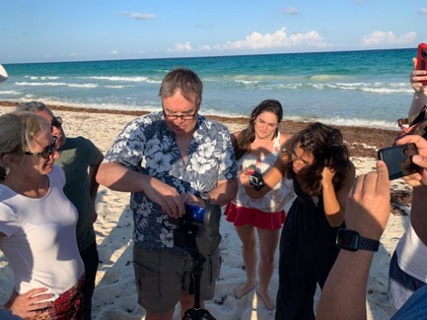
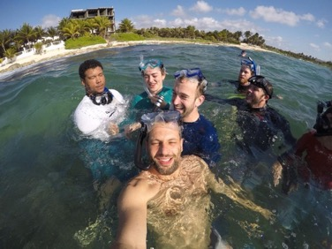
MBON Pole to Pole of the Americas
People working together to observe marine biodiversity and understand how and why it changes for the benefit of society
Standardized methodologies and data workflows
Data and knowledge sharing
Technology sharing and transfer
Capacity building

Slide 4
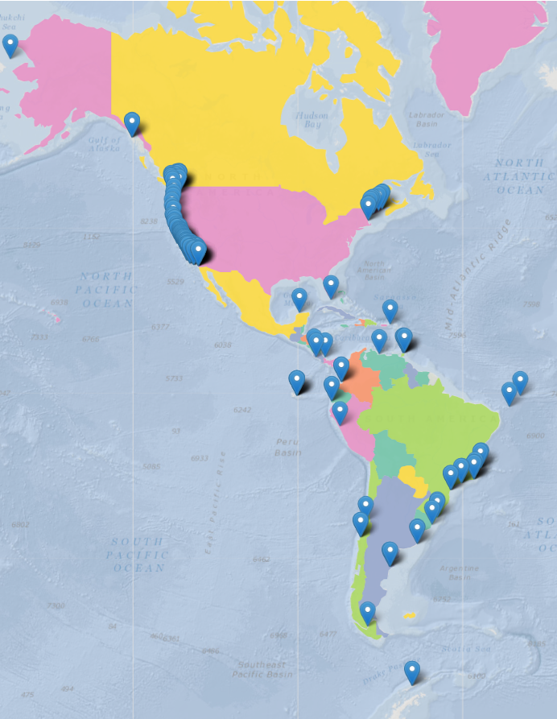
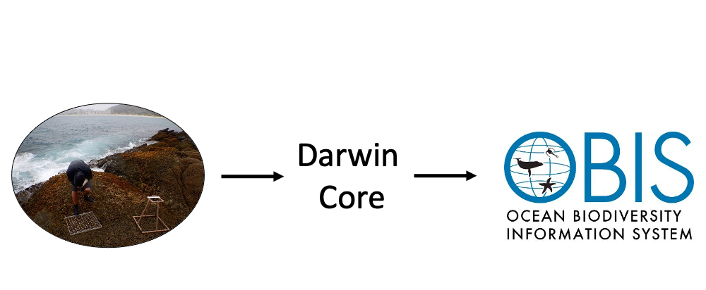
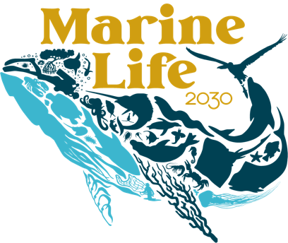
EOV’s
Notes:
The general philosophy is to gather biological and biodiversity observations using common standards and best practices, align data to the Darwin Core standard, and make data publicly available through OBIS so that these observations can be used to compute EOV’s for biology and ecosystems in support of international frameworks like ML2030 of the UN Decade.

Slide 5
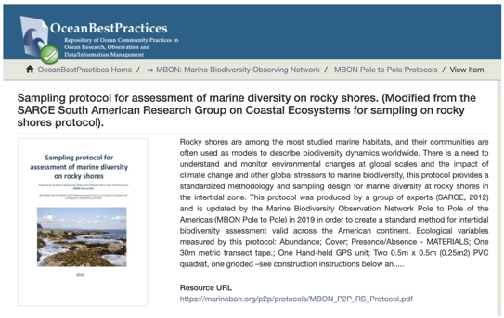
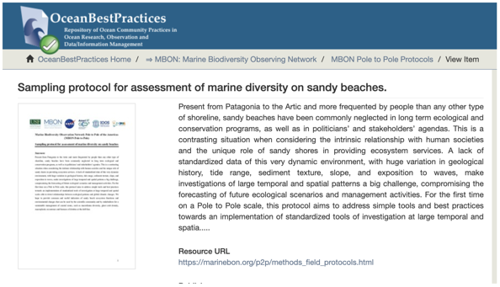
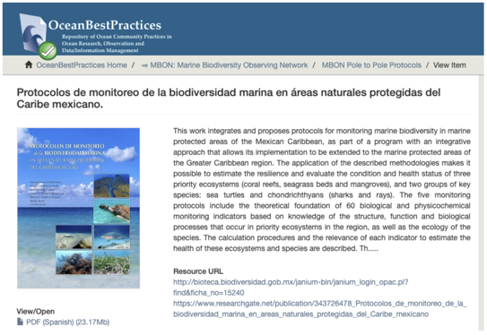
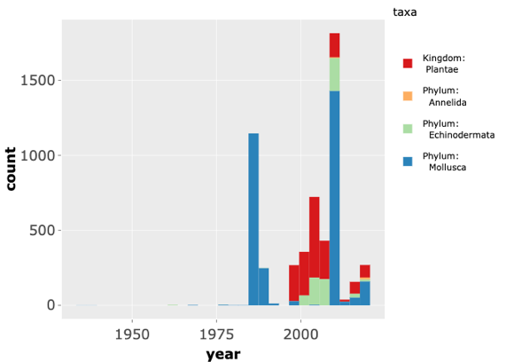
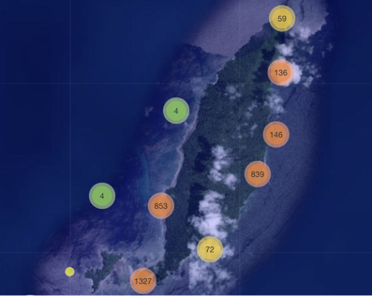
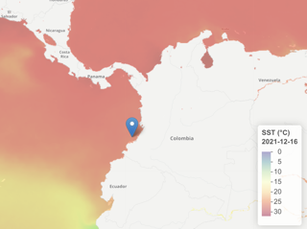
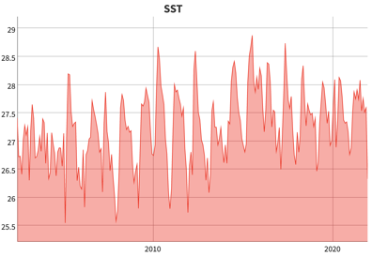
Standardized biodiversity monitoring protocols
Mollusca

Slide 6
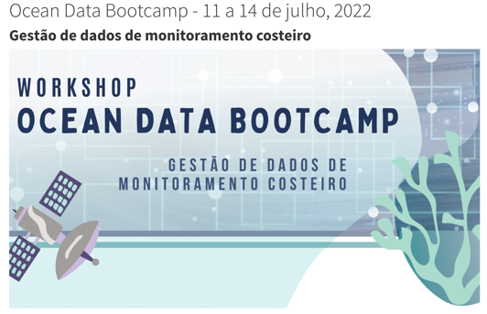
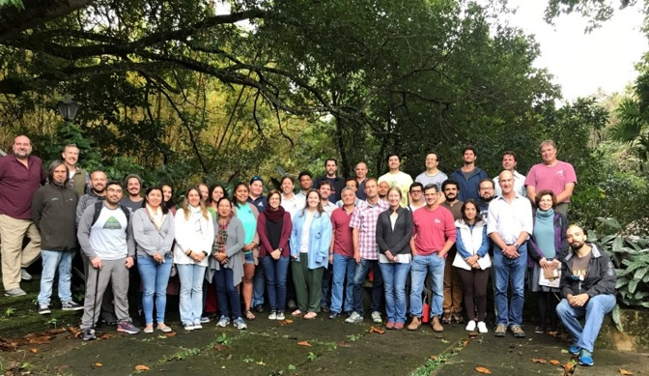
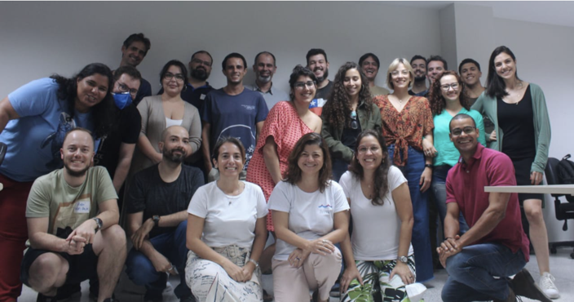
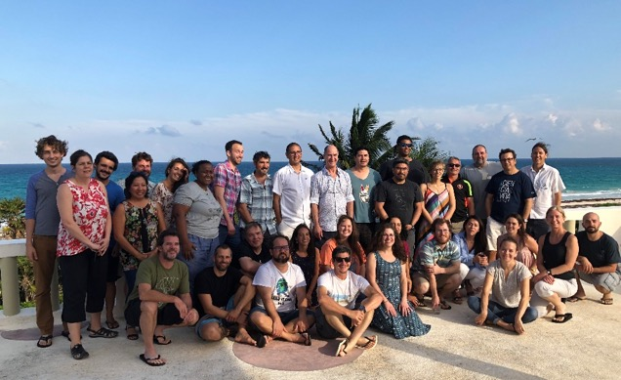
MBON Pole to Pole: Building capacity in biodiversity monitoring
2018 - Brazil
2022 - Brazil
2019 - Mexico
https://eqmh.github.io/Ocean_Data_Bootcamp/

Slide 7
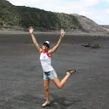
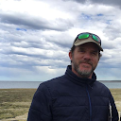
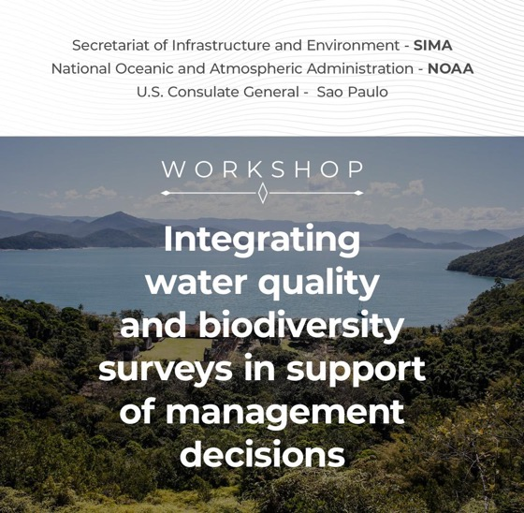
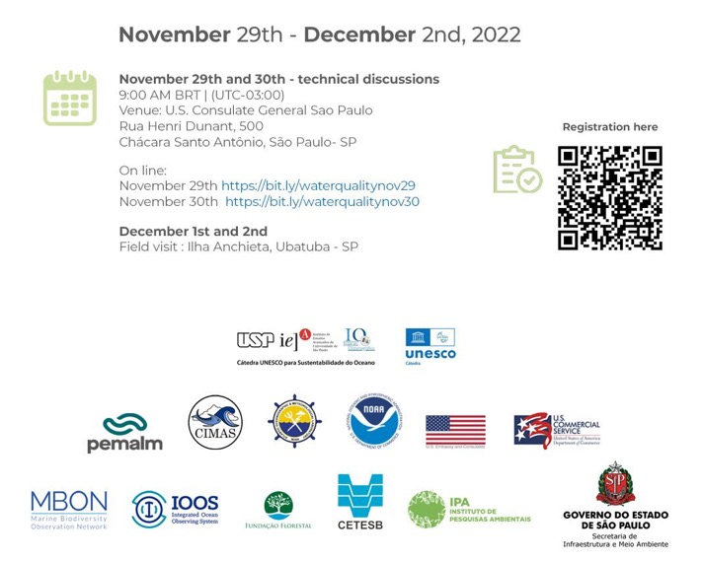
Kelly Montenero
Willem Klajbor
Luke Thompson
Enrique Montes
34 participants from SIMA, US Embassy, NOAA, U. Sao Paulo.
14 Industry partners invited.

Slide 8
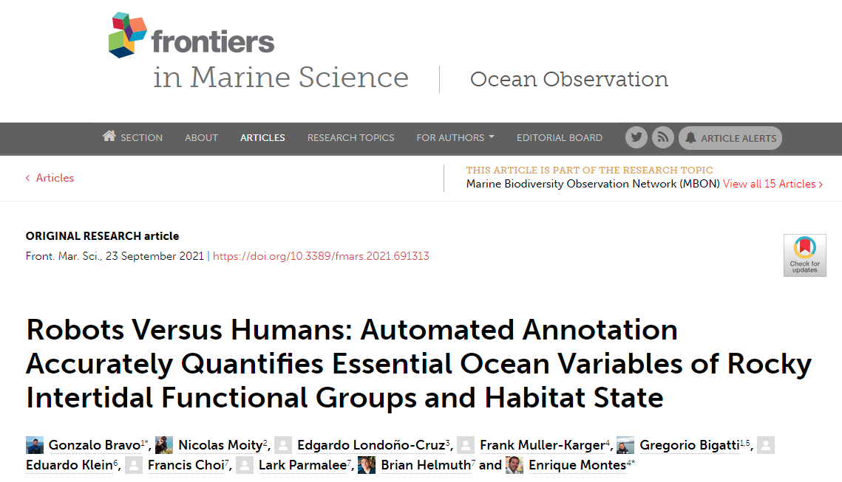
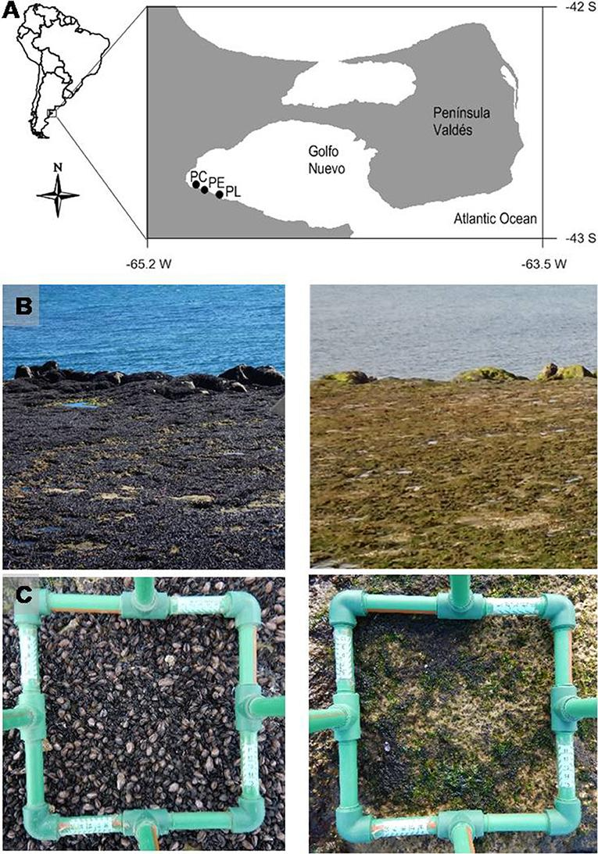
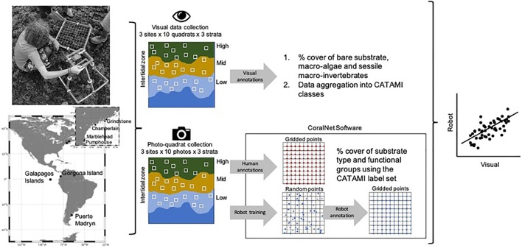
Applying machine-learning tools for biodiversity monitoring
“It took less than a year for mussel cover to drop from 90 to almost 0%”
February 2018
May 2019
Mendez et al 2021
Front. Mar. Sci. https://doi.org/10.3389/fmars.2021.620866
Notes:
The network is implementing AI applications for automated extraction of taxonomic records from photo-quadrat imagery to track shifts in percent live cover of functional groups and key species.
These tools can aid in expanding the spatial extent and frequency of biodiversity surveys and thus help in capturing major die-off events like the one shown in this slide where the percent cover of mussel bed of several sites in Golfo Nuevo, Patagonia, dropped from around 90% to zero within months.

Slide 9
Notes:
We have tested this approach with encouraging results showing that live cover estimates from this particular application (CoralNet) match visual inspections on the field pretty well.

Slide 11
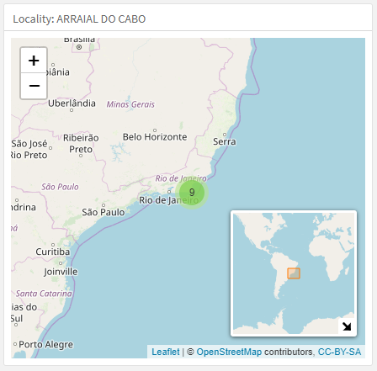
Developing biodiversity indicator dashboards
Example: Rocky shore at Arraial do Cabo – Brazil
@ameriGEOSS
www.amerigeoss.org
Notes:
These records are now being used to produce biodiversity indicators such as … in a particular monitored area, and tools to communicate them to managers and policy-makers using simple visualizations summarized in flexible and dynamic data dashboards.

Slide 12
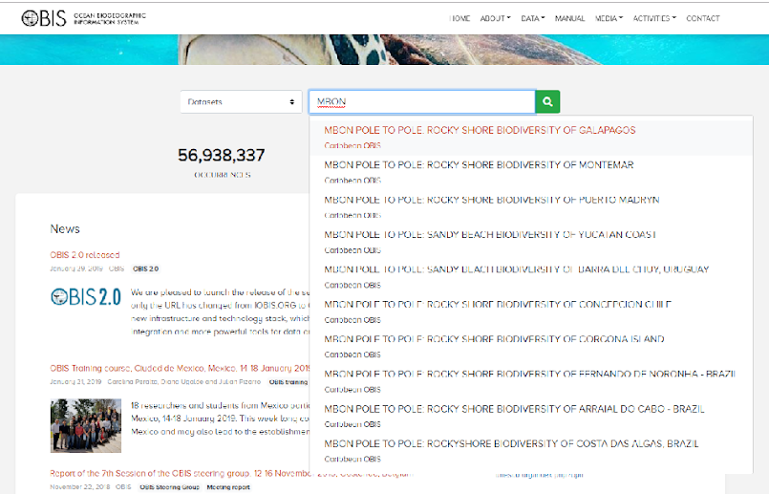
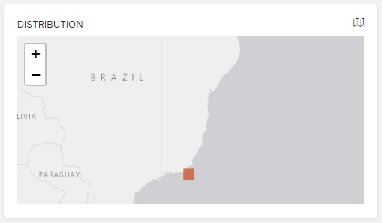
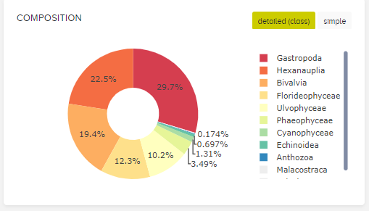
Publishing data in OBIS
@ameriGEOSS
www.amerigeoss.org
https://www.gbif.org/en/installation/bd4746e4-c1e1-4a68-8546-10a853c64853

Slide 13
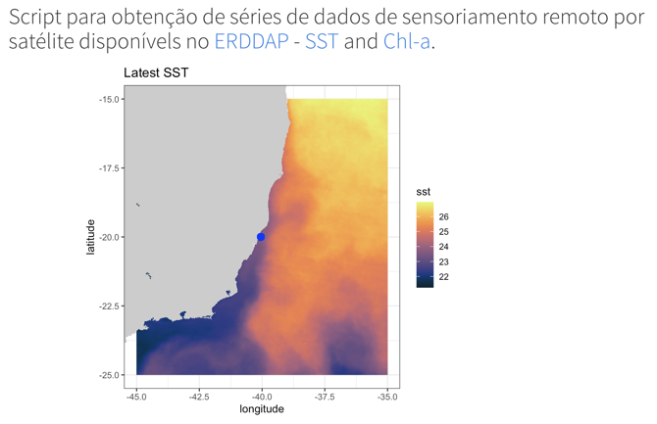
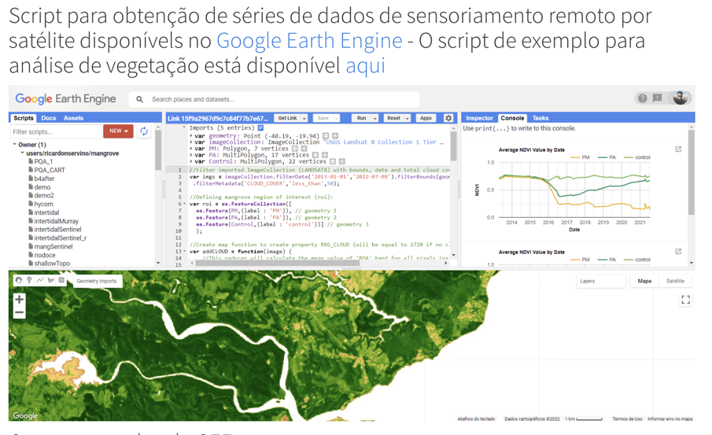
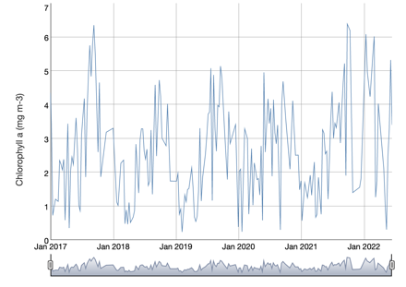
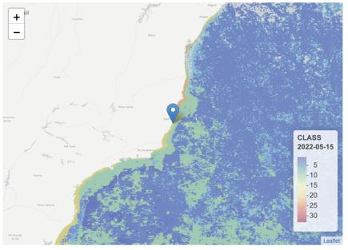
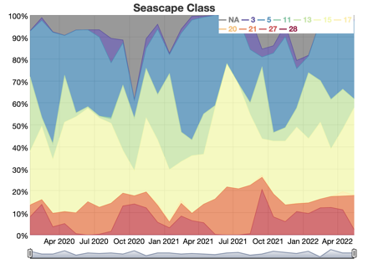
Integrating in situ biodiversity data with satellite records

Slide 14
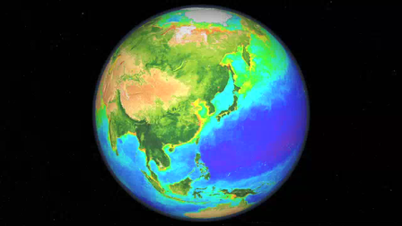
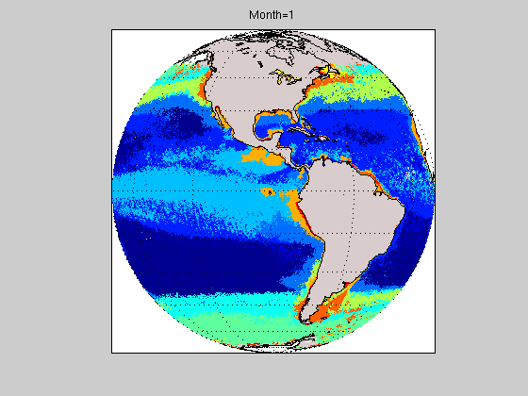
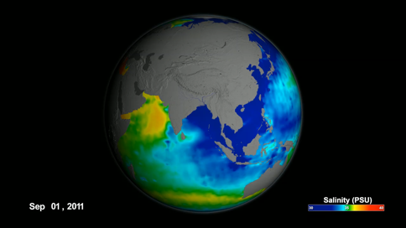
Dynamic biogeographic seascapes
Multiple NASA assets
Global dynamic classification
Biology: Ocean Color
Machine learning
Globally relevant variables:
SST, Chl-a, nFLH, ADT, SSS, CDOM, ice cover
8-day and monthly composites
5 km pixel resolution
N= 33 (including sea ice)
Physics: e.g.
SSS, SST, winds, SSHa

Slide 15
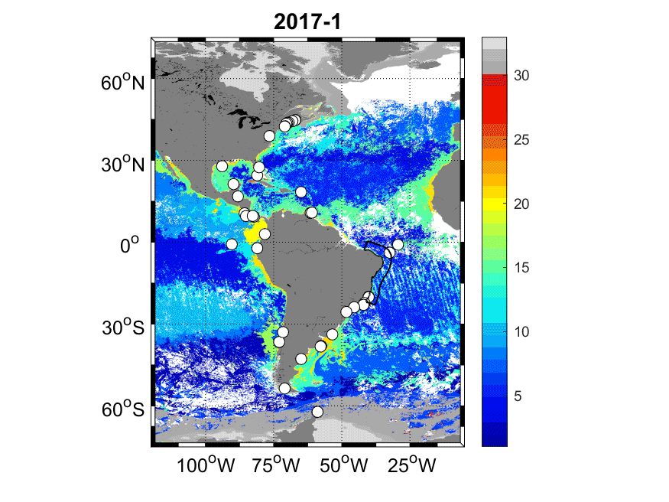
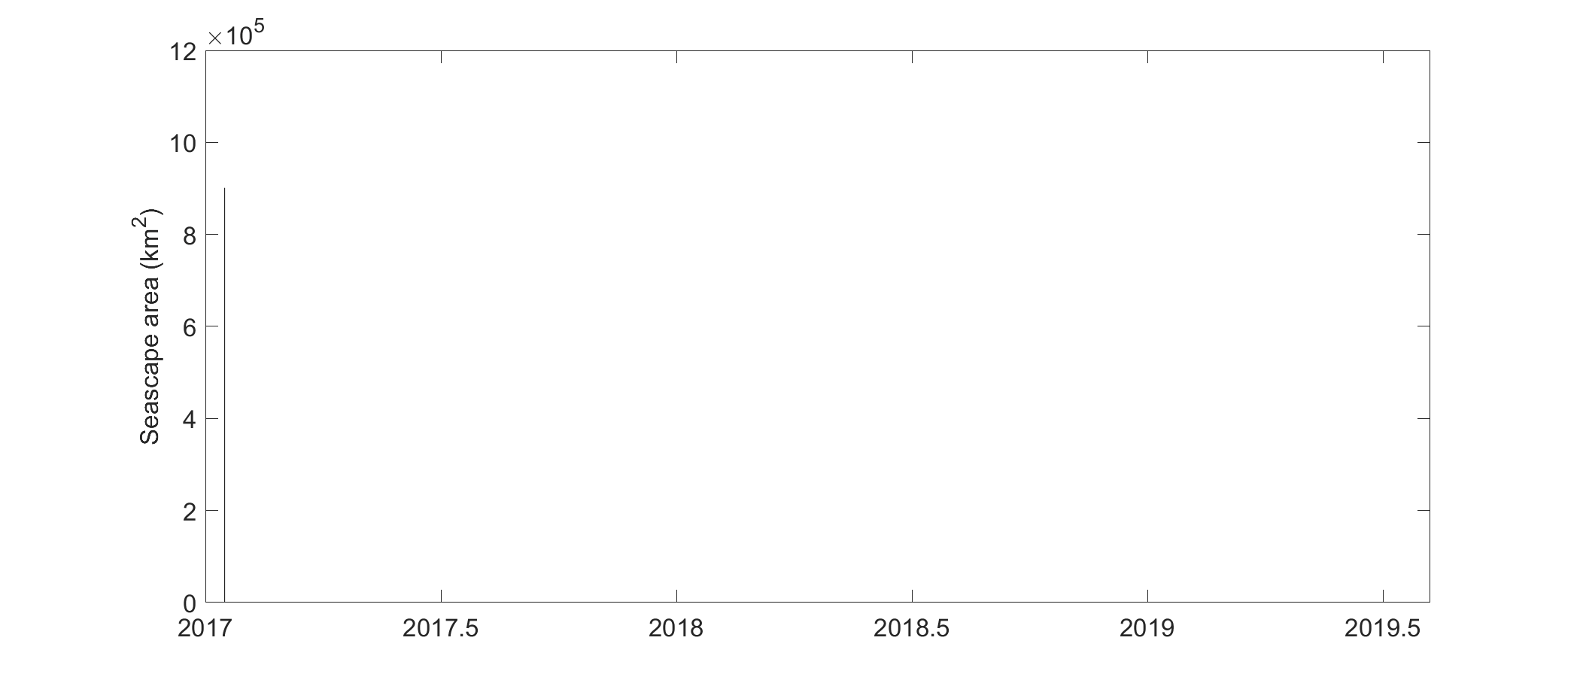
Using dynamic seascape maps for biodiversity and species assessments
Global classification of surface waters at 5 km pixel res.
Eastern Brazilian Shelf
Seascape
class
monitoring sites
Notes:
An important part of this effort consist of providing satellite remote sensing products and analysis tools to enable the assessment of biodiversity patterns over time and space.
The network is employing a global and dynamic classification of ocean biomes developed by my colleague Maria Kavanaugh at OSU that we call satellite seascapes. This classification is constructed using a machine learning algorithm that clusters multiple types of satellite data into 33 categories with distinct biogeochemical properties.

Slide 16
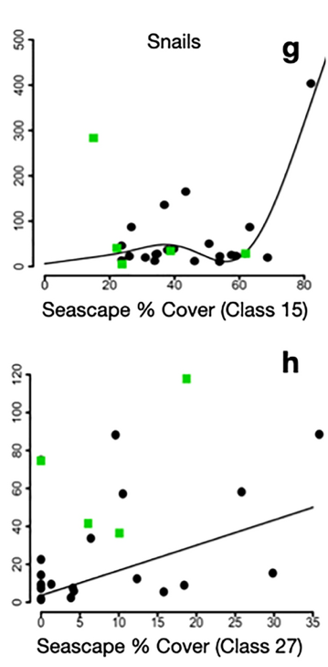
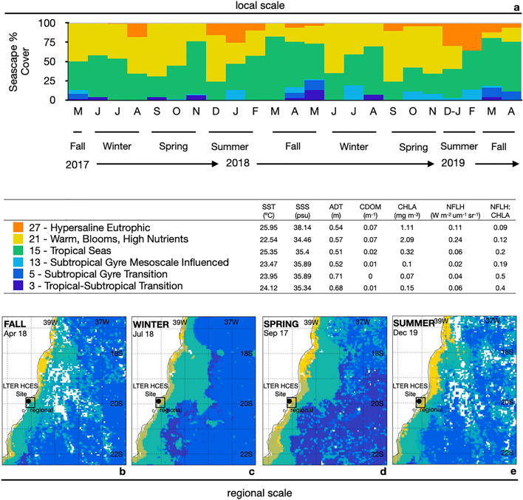
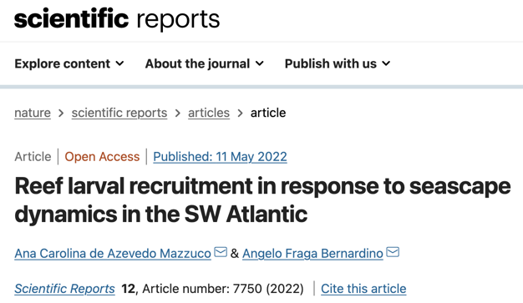
Capacity Building – Use of dynamic seascape maps
Snails
Crab/Shrimp
Notes:
Seascapes are now being used by network members to understand shifts in biodiversity of, for example, reef larvae.
In this study our colleagues from UFES coupled 16 years of repeated larval recruitment data from the eastern Brazilian coast with the extent of dominant seascape categories in this region. They found that the abundances of snail larvae and of other invertebrate species in the coastal zone are associated with the fractional extent of Tropical Seas and Hypersaline Eutrophic seascapes, respectively.

Slide 17
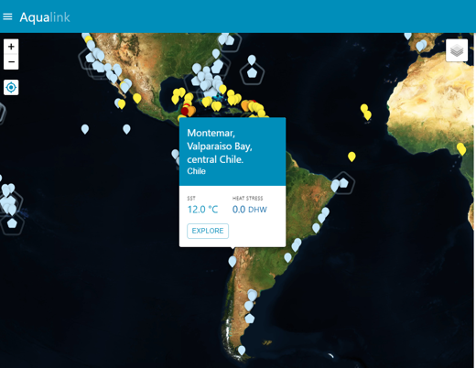
Aqualink Smart Buoys

Slide 18
MBON Pole to Pole leads in Brazil
Cesar Cordeiro
Antonio Marques
Maikon Di Domenico
Ana C. Mazzuco
Guilherme Corte
Carlos Barboza
Augusto Flores
José Muelbert
Yasmina Shah Esmaeili

Slide 19
Summary of Brazil-US collaborations under the MBON Pole to Pole:
Six universities participating in the network: UFES, UFRJ, UFF, UFPR, UENF and USP.
The Brazilian LTER program (PELD) supports the network:
Cabo Frio, Abrolhos Bank
Costa das Algas
Brazilian Oceanic Islands
Restingas, Rio de Janeiro (RLaC)
PELD data
UFES now manages the Brazil OBIS Node.
MBON Pole to Pole workshop in 2022
MBON Pole to Pole activities also supported by

